Slide 1
UW MADISON
DEPARTMENT OF PHYSICS
CHAMBERLIN HALL
OPTION 1

Slide 2
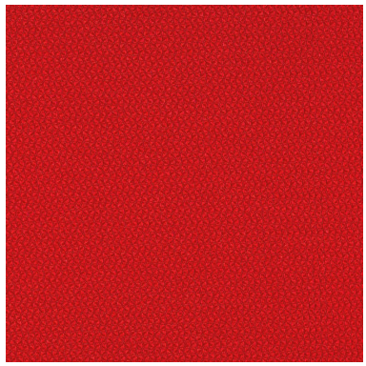
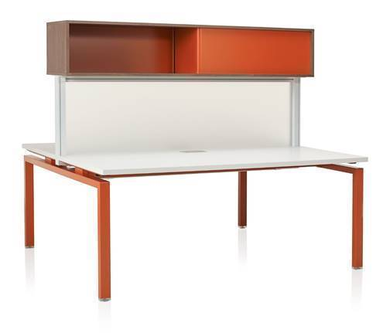

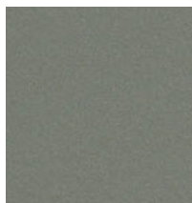
STYLE LINKS DESKING UNITS
Tack board Fabric
Pact Roma
Laminate
High Rise
Paint finish on legs and overhead
Starlight Silver

Slide 3
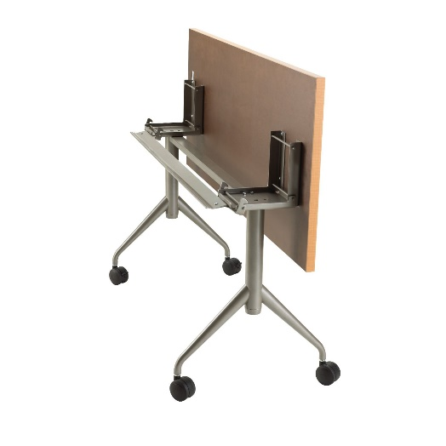
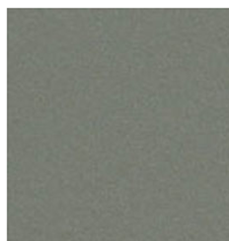
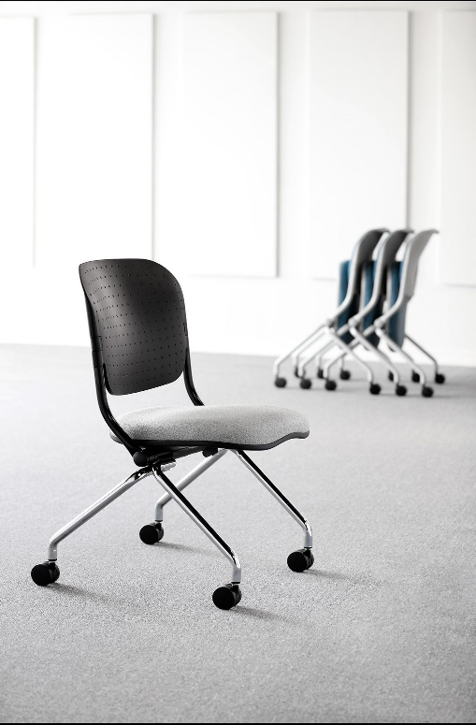
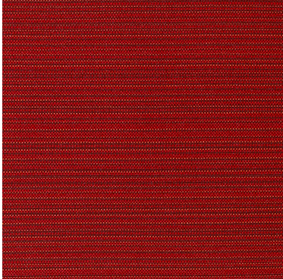
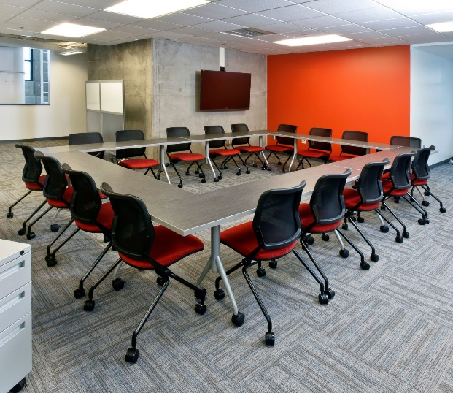
FLIP TOP MOBILE TABLE AND NESTING CHAIRS
Skip Ruby Fabric with Starlight Silver Frame color
High Rise Laminate with Starlight Silver Base

Slide 4
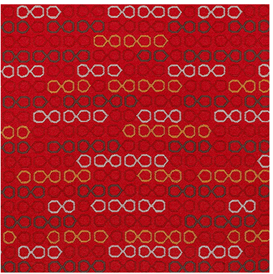
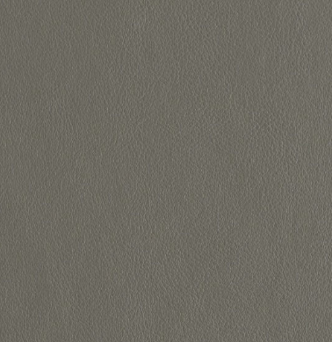
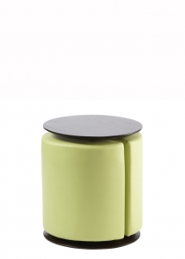
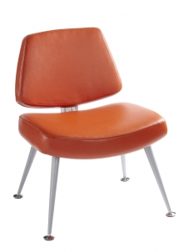
LOUNGE FURNITURE
Lens Crimson
Upholstery Fabric
Florentino Dove Faux Leather

